Slide 1
Introduction to Soldering
James Cook University

Slide 2
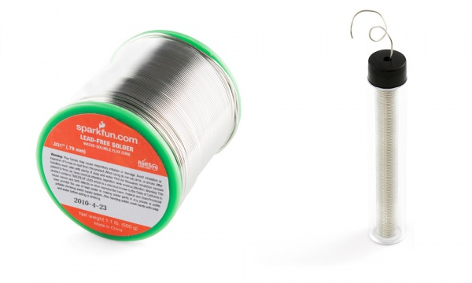
What is solder?
Solder is a metal with a low melting point used to create a good electrical connection.
It also helps hold the parts to the board.

Slide 3
Typical chemistries
Chemistry | Melting point | Notes
Tin / lead (SnPb) Typical: 63% tin / 37% lead | 183 deg C | Often considered to be the easiest to work with. Often considered to produce the highest quality products. Lead is toxic so this is a health and environmental hazard.
Tin / silver / copper (SnAgCu – SAC) Typical: 96.5% Sn / 3% Ag / 0.5% Cu These ratios vary between products. Often trace quantities of other metals are added. | 217 deg C | Most common lead-free solder.
Tin / copper (SnCu) | 227 deg C | Cheaper due to absence of Ag

Slide 4

RoHS (reduction of hazardous substances)
The Reduction of Hazardous Substances (RoHS) directive was adopted in the European Union in 2003.
RoHS prohibits leaded solder for electronics products sold in the EU.
Due to the size of the EU market, this has had a huge influence on the global electronics industry.
Almost all mass-manufactured electronics products now use lead-free solder.

Slide 5
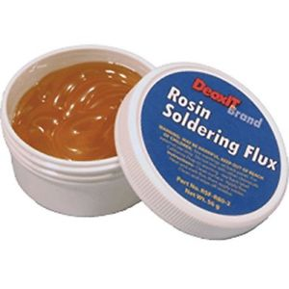
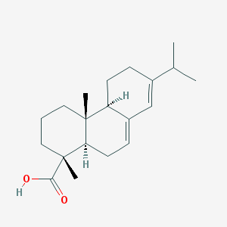
Solder flux
A flux is a chemical cleaning agent used during the soldering process.
A traditional material is rosin, obtained from pine trees.
Pine trees secrete liquid called resin as a protective mechanism; this is heated and dried to produce rosin.
Rosin is mainly an organic acid that is noncorrosive at room temperature. When heated it reacts with metal oxides.
Synthetic fluxes are also used.
Abietic acid, a major component of rosin
Structure from PubChem

Slide 6
Impact of flux
The flux is an acid that cleans the surface to be soldered.
Specifically, it reduces metal oxides to clean metal.
The flux and its chemical reactions with metal oxides cause smoke to come off when soldering.
Solder almost always contains a core of flux.
You can also buy flux separately; it’s especially useful when repairing old boards.

Slide 7
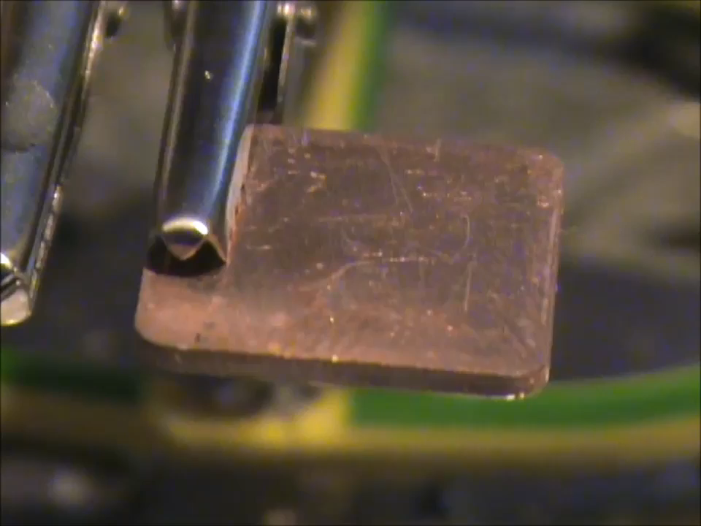
Solid solder (no flux) vs flux cored solder
Video credit: https://www.youtube.com/watch?v=B1cIjXWdLyw

Slide 8
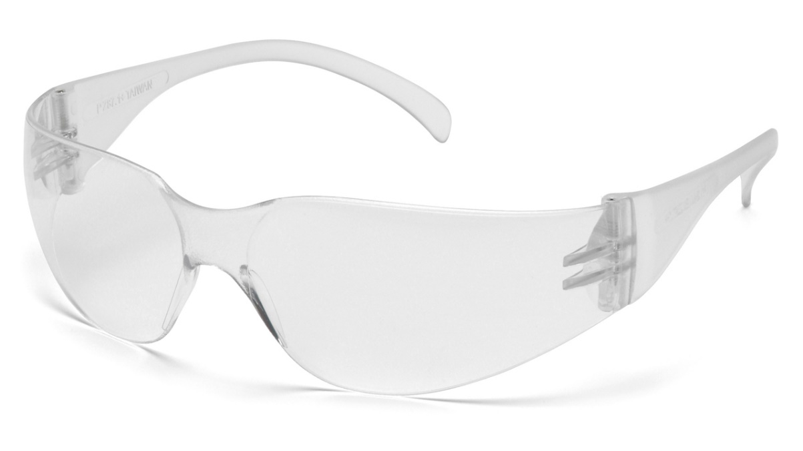
How to solder: safety
A soldering iron is very hot and will burn you. A typical temperature is 300 – 350 °C.
If you drop it, let it fall! Do not try to catch it.
Wear safety glasses at all times when soldering.

Slide 9
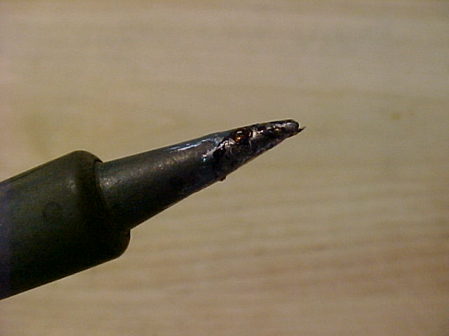
How to solder: preparation
Clean the soldering iron tip.
Use a damp sponge or brass wire to clean the tip and get it nice and shiny.
Optional: “tin” the tip by putting a small amount of solder onto the tip of the soldering iron.

Slide 10
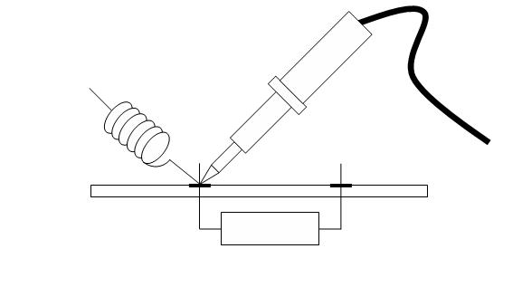
How to solder: part 1
Poke the component through the hole and cut any long wires.
Press the soldering iron to the pad and the component.
Your goal is to heat up the pad and the component leg.

Slide 11
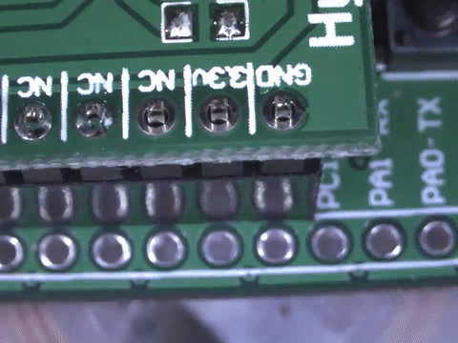
How to solder: part 2
Bring in the solder from the other side of the pad.
Don’t touch the solder directly onto the soldering iron. Let the hot pad melt the solder and it will flow nicely.

Slide 12
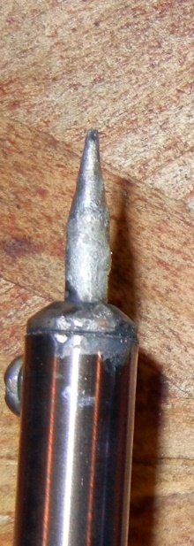
Anatomy of a tip: contact area
Soldering is about heat transfer.
To get good heat transfer, use the flat side of the iron against the pad.

Slide 13
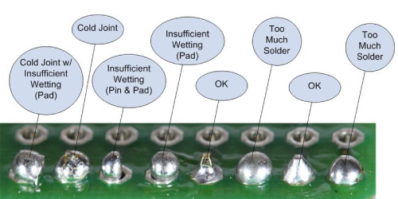
Correct amount of solder

Slide 14
Practical exercise
Practice soldering through-hole components

Slide 15
Part 2: surface mount soldering

Slide 16
Hand soldering a surface mount resistor

Slide 17
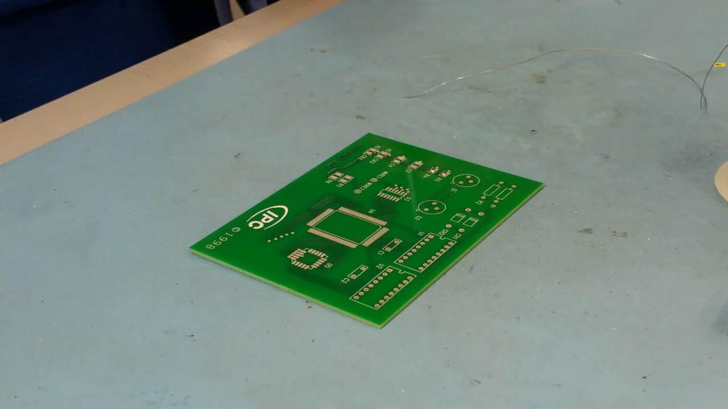
Video credit Newbury Electronics https://www.youtube.com/watch?v=pd6BuGkRhGA

Slide 18
Solder paste
For smaller components, solder paste and a reflow oven are used.
Solder paste is powdered solder suspended in flux.
Some fluxes leave behind a residue that should be cleaned off the board.
Use isopropyl alcohol and a stiff brush to clean flux residue.

Slide 19
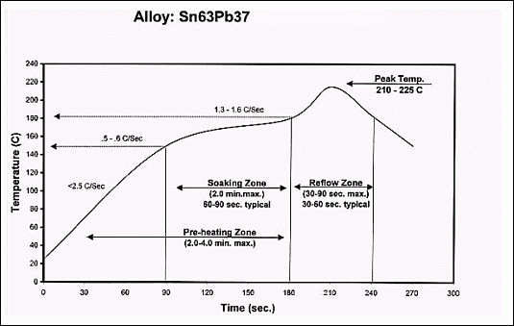
Reflow soldering
A reflow oven controls the temperature according to a particular programmed pattern.

Slide 20
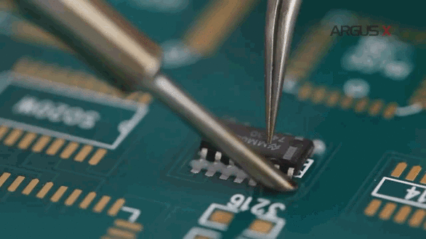
Solder paste surface tension

Slide 21
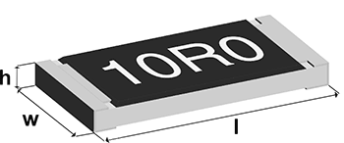
Surface mount resistors
Two standards: metric and imperial.
Always a 4 digit code specifying “length” and “width”.
Common sizes:
Size code (imperial) | Length (l) | Width (w) | Size code (metric) | Length (l) | Width (w)
0603 | 60 mils = 0.06” | 30 mils = 0.03” | 1608 | 1.55 mm | 0.85 mm
0805 | 80 mils = 0.08” | 50 mils = 0.05” | 2012 | 2.0 mm | 1.2 mm
1206 | 120 mils = 0.12” | 60 mils = 0.06” | 3216 | 3.2 mm | 1.6 mm

Slide 22
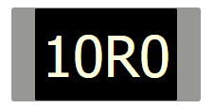
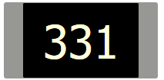
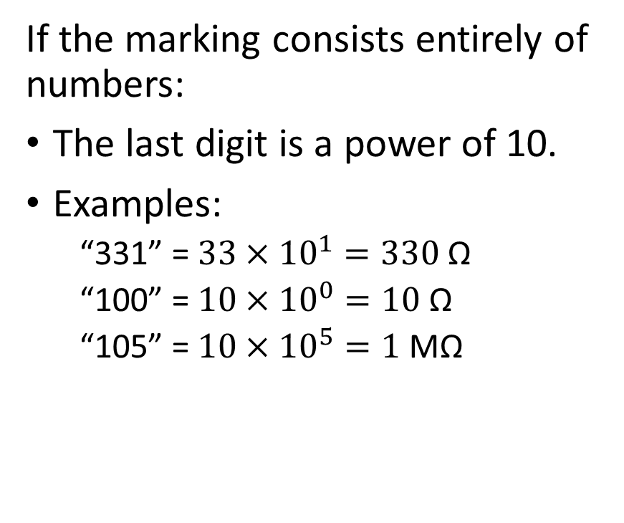
SMD (surface mount device) resistor markings
If the marking has an “R” at the start or in the middle:
The R is a decimal point.
Examples:
“R10” = 0.10 Ω
“10R0” = 10.0 Ω
If the marking consists entirely of numbers:
The last digit is a power of 10.
Examples:
“331” = $33×{10}^{1}=330$ Ω
“100” = $10×{10}^{0}=10$ Ω
“105” = $10×{10}^{5}=1$ MΩ
NB: There is another standard “EIA-96” used for 1% tolerance (and sometimes 5%). EIA-96 uses numbers and letters, e.g. “22A”. These require a look-up table. Confusingly, one of the letters is R! The EIA-96 standard always places the letter last.

Slide 23
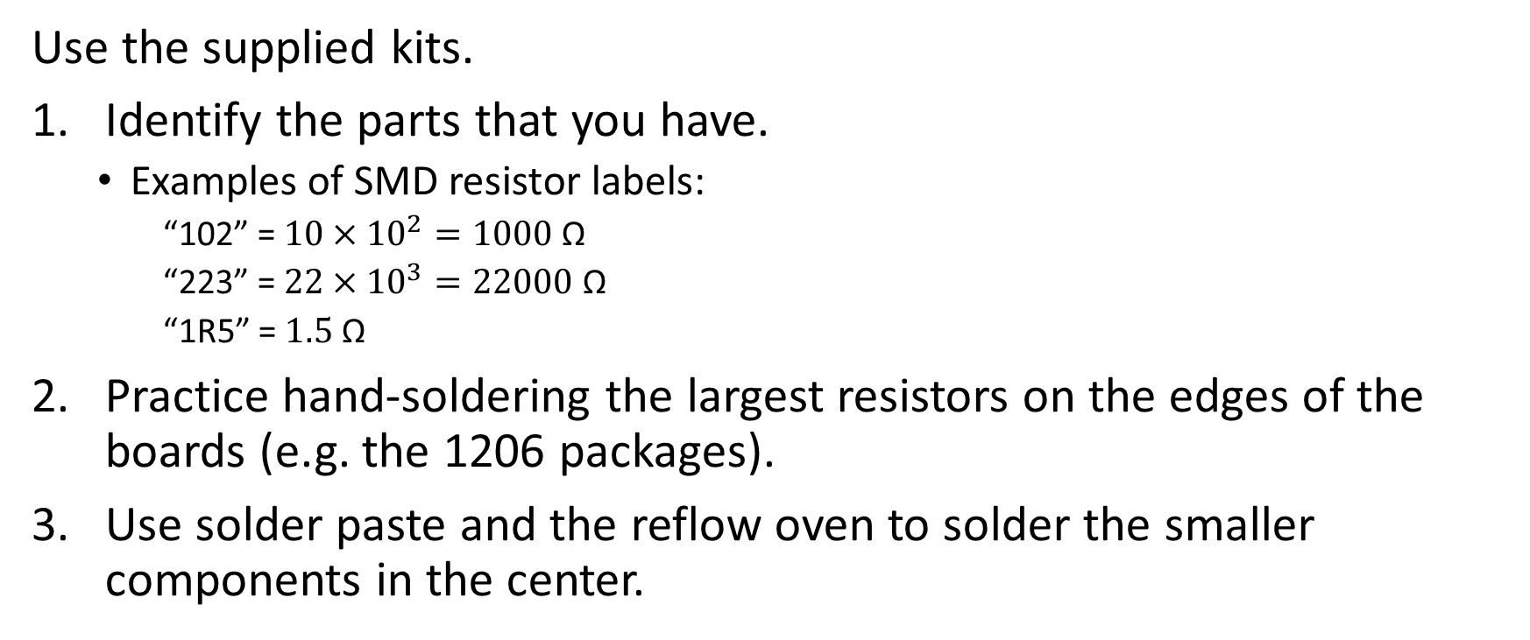
Surface mount soldering practice
Use the supplied kits.
Identify the parts that you have.
Examples of SMD resistor labels:
“102” = $10×{10}^{2}=1000$ Ω
“223” = $22×{10}^{3}=22000$ Ω
“1R5” = $1.5$ Ω
Practice hand-soldering the largest resistors on the edges of the boards (e.g. the 1206 packages).
Use solder paste and the reflow oven to solder the smaller components in the center.

